Slide 1
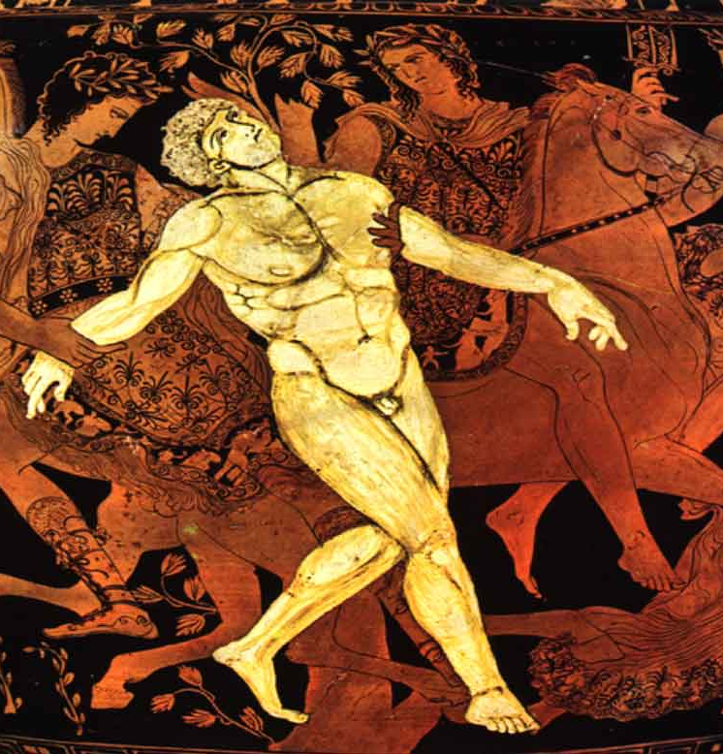
ANCIENT DREAMS OF
ARTIFICIAL LIFE
From Greek mythology to the conceptual roots of autonomous machines
TALOS • PANDORA • PYGMALION
Myths imagined artificial beings long before digital technology.
Historical bridge for Medical AI • Session 1

Slide 2
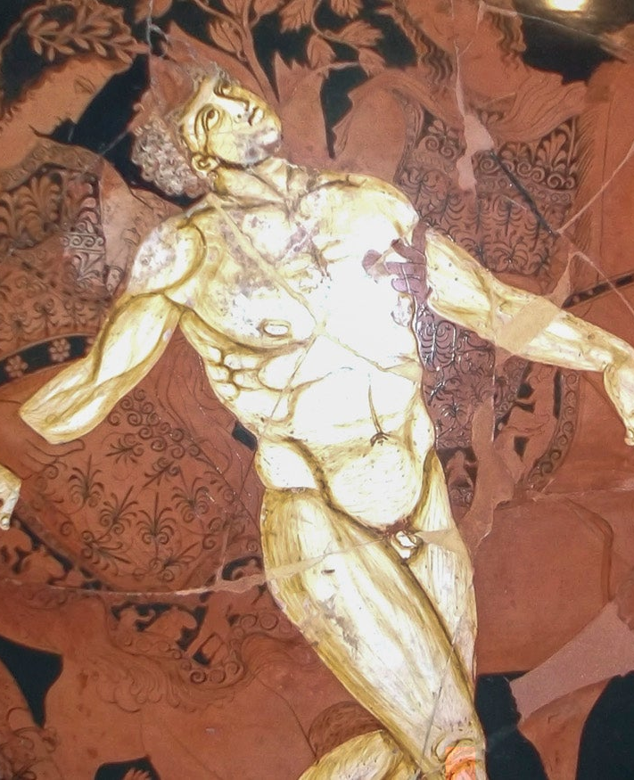
TALOS — THE BRONZE GUARDIAN
A mythological automaton protecting Crete
MISSION
Protect the island
PATROL
Circle the coast
RESPONSE
Repel intruders
MODERN ANALOGY
Sense → Decide → Act
Mythological analogy — not a historical AI machine.

Slide 3
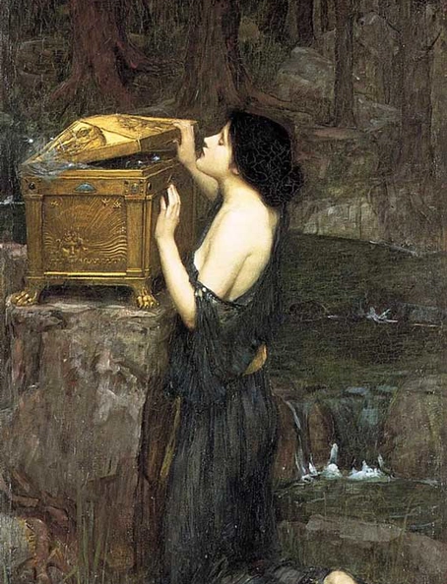
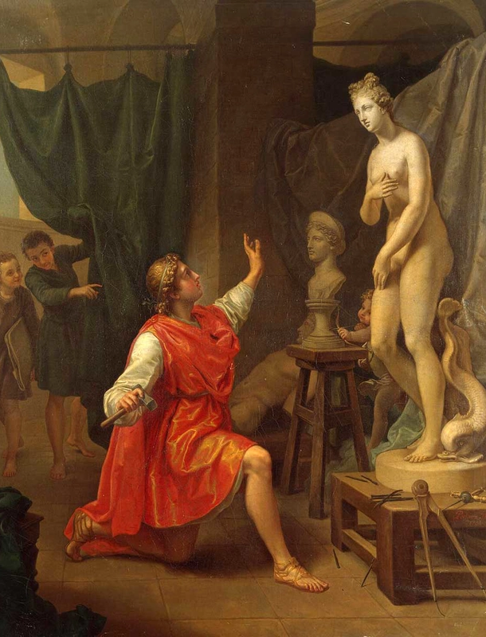
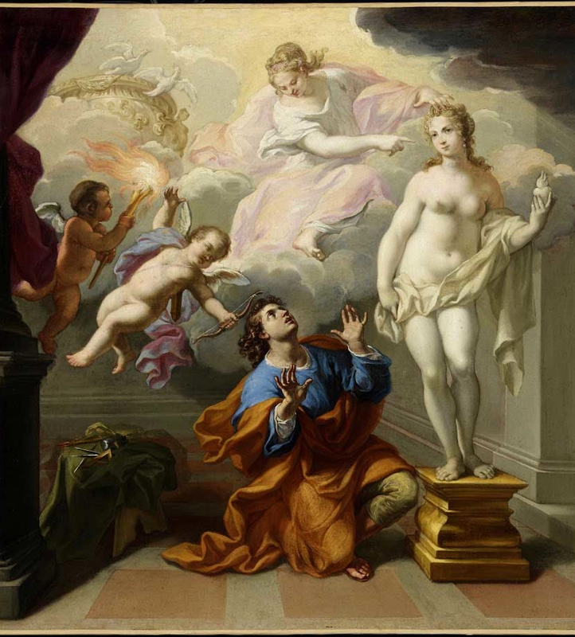
PANDORA & PYGMALION — CREATING ARTIFICIAL LIFE
PANDORA
PYGMALION / GALATEA
ARTIFICIAL BEING AS CREATION
Teaching question: If humans can create an intelligent artificial agent, who is responsible for its actions?

Slide 4
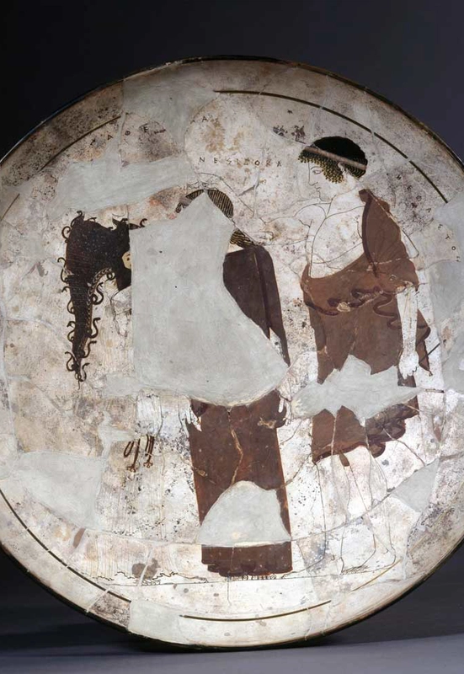
FROM MYTH TO FORMAL REASONING
Ancient Greek thought also developed systematic approaches to reasoning.
RULE 1
All humans are mortal
RULE 2
Socrates is human
CONCLUSION
Socrates is mortal
Formal logic → later symbolic / rule-based AI
Aristotle did not invent AI; this is a historical intellectual connection.

Slide 5
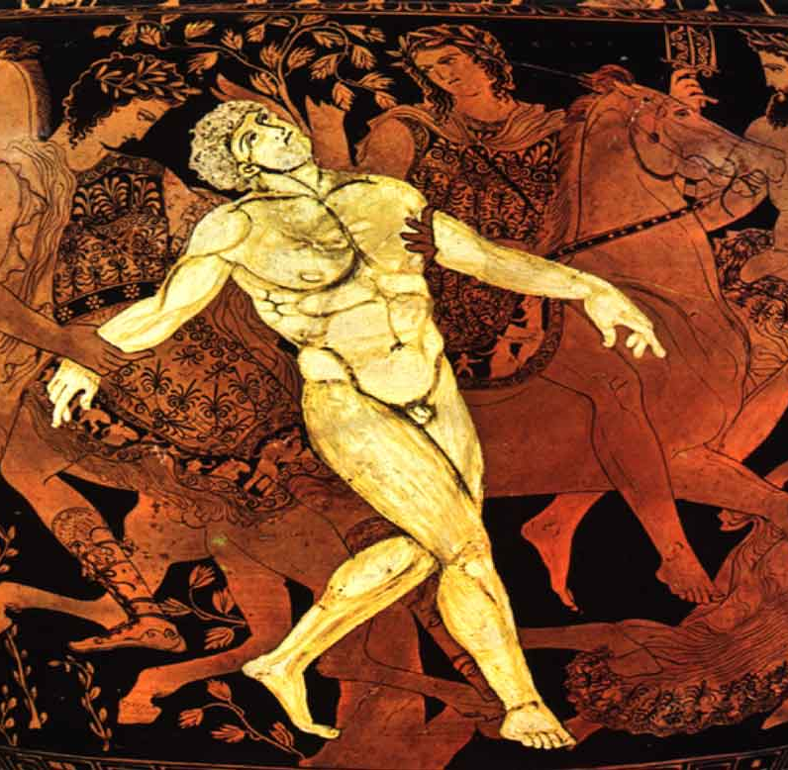
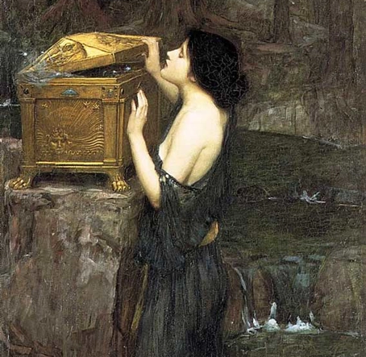
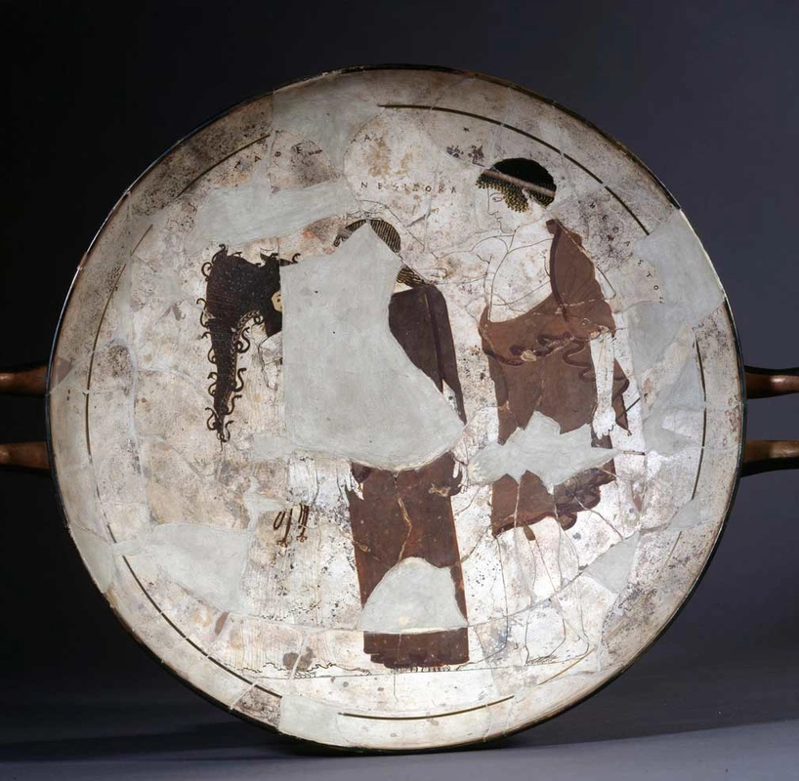
2,700 YEARS OF IDEAS → TODAY'S MEDICAL AI
TODAY'S MEDICAL AI
EHR + imaging + labs
Machine learning / DL
~700 BCE
Greek myth
Classical Greece
Clinical decision support
TALOS
PANDORA
LOGIC
Autonomous agent
Artificial being
Formal reasoning
WHAT CHANGED?
DATA + COMPUTING POWER + ALGORITHMS + DIGITAL HEALTHCARE
Next: Session 2 — Fundamentos de IA, ML, DL y GenAI

Slide 6
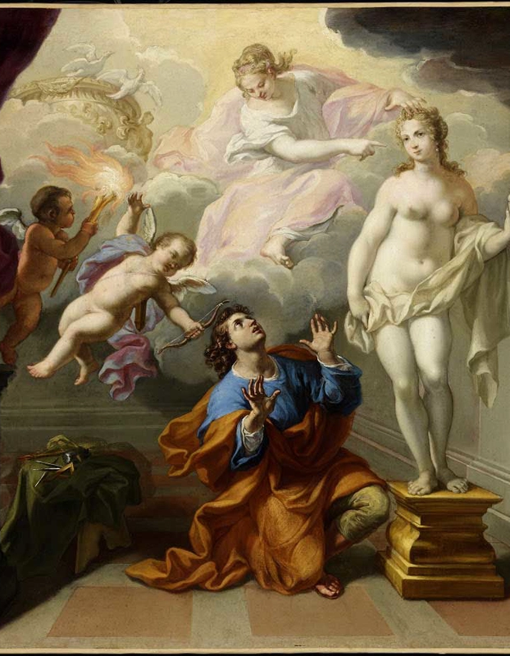
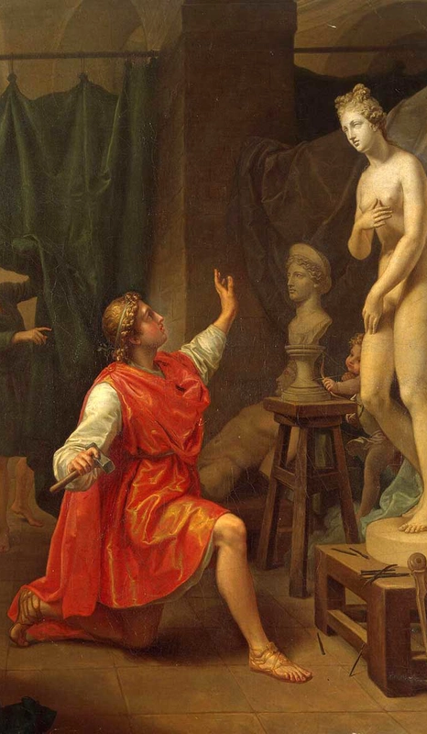
DAEDALUS & HEPHAESTUS — THE DREAM OF SELF-MOVING MACHINES
SELF-MOTION
Objects imagined to move or act without continuous human control
ARTIFICIAL SERVANTS
Hephaestus' golden attendants and other crafted beings
THE MODERN QUESTION
Which tasks should machines perform autonomously?
Myth → automation concept → robotics → AI-assisted systems
Historical myths are conceptual precursors, not evidence of ancient digital AI.

Slide 7
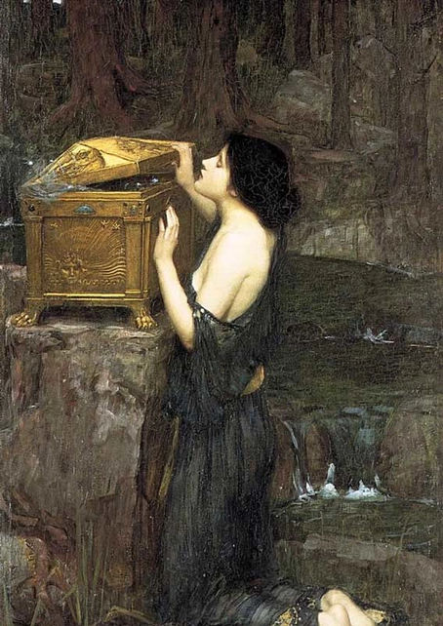
ANCIENT QUESTIONS THAT STILL MATTER IN MEDICAL AI
CONTROL
Who remains responsible when an AI system acts?
SAFETY
What happens when a powerful technology behaves unexpectedly?
HUMAN VALUES
Should every task that can be automated be automated?
MEDICINE
How do we preserve clinician oversight, patient safety and trust?
PANDORA
Powerful creation → unintended consequences
Medical AI = capability + validation + governance + human responsibility

